Slide 1





GAME DEV
DESIGN
DEVELOPMENT

Slide 2


the Question
WHAT IS CONSIDERED
A GAME
PLAYER
RULES
VICTORY CONDITION

Slide 3


HOW DO WE
DEVELOP
A VIDEOGAME?
GAME ENGINES

Slide 4

Paperwork!

Slide 5

HOW TO PLAY
There are 3 game Fundamentals !
GAME
MECHANICS
GAME
FEEL
GAME
ART

Slide 6
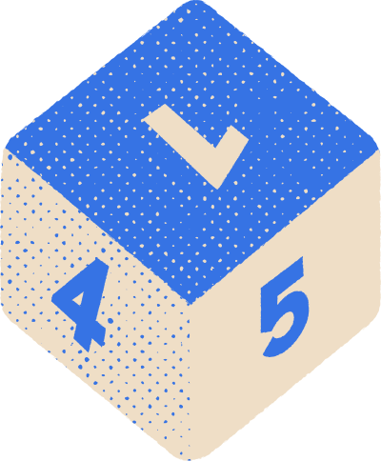






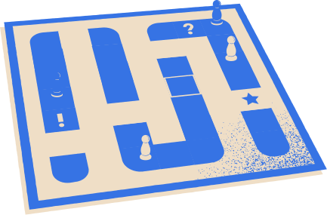
GAME
MECHANICS
WHAT YOU DO

Slide 7





GAME
FEEL
HOW IT FEELS

Slide 8
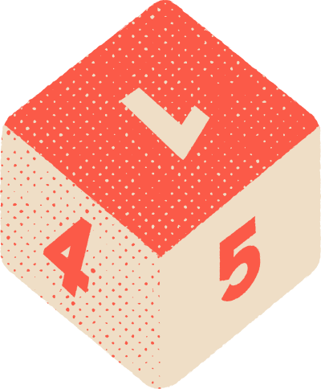




GAME
ART
HOW IT LINGERS

Slide 9


Slide 10
Paperwork!

Slide 11



THANKS
FOR PLAYING

